Slide 1
Data R’sizlari
Ahmet Turhal
Istem Akca Korkmaz
Mustafa Kurt
Serhan Suer
Ufuk Baysal
Turkey Food Prices
26 Dec 2018

Slide 2
Turkey Food Prices
Key Takeaways
Dataset
Dataset: Turkey Food Prices from WFP
Analysis:
Initial: yearly average prices by category and market
Exploratory: yearly average food prices in each category
Overall price increase in 2018
Most significant price changes:
Cereals and Tubers Rice and bread
Meat, Fish and Eggs Fresh fish & mutton meat
Milk and Dairy Milk powder for infants
Miscellaneous Food Cocoa and instant coffee
Oil and Fats Olive oil
Pulses and Nuts Groundnuts
Vegetables and Fruits Cucumbers, eggplants and onions
Major reasons of price increases:
Climate change
Natural causes
Currency rates crisis
Higher demand
Insufficient supply
Shiny
Turkey Food Prices from WFP
52 different kinds of foods
8 main categories
4 markets
Data from May 2013 incl. 4,718 rows & 15 columns.
Loading The Data & Data Preprocessing
Headline setting, elimination of unnecessary data and format adjustment
Creating an organized rds file and uploading it to GPJ
Data Summary after Preprocessing
date : Date
name : Food name
unit : Unit of measure
type : Food category
value : Food price
currency : Curreny (TRY)
market : Related market name (Ankara, Istanbul, Izmir and National Average)
year : Year
month : Month

Slide 3
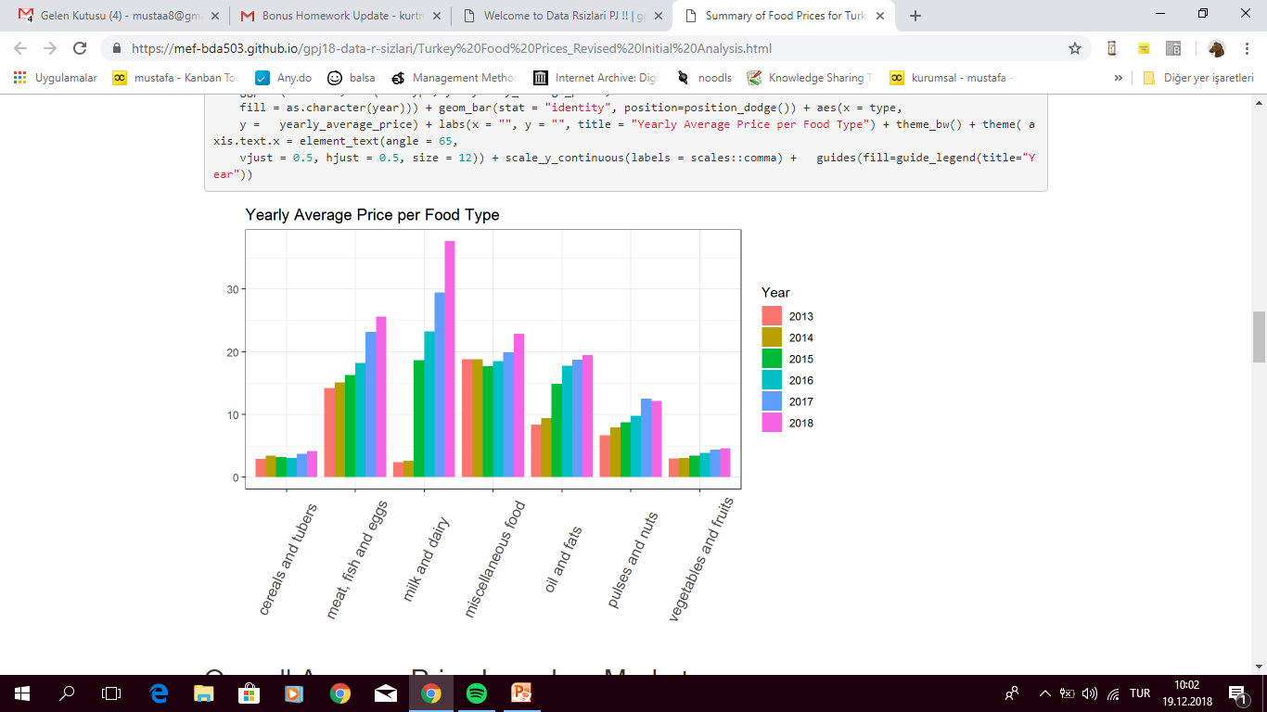
Yearly Average Prices Per Food Type
Cereals and tubers
Meat, Fish and Eggs
Milk and Dairy
Miscellaneous food
Oil and Fats
Pulses and Nuts
Vegetables and Fruits

Slide 4
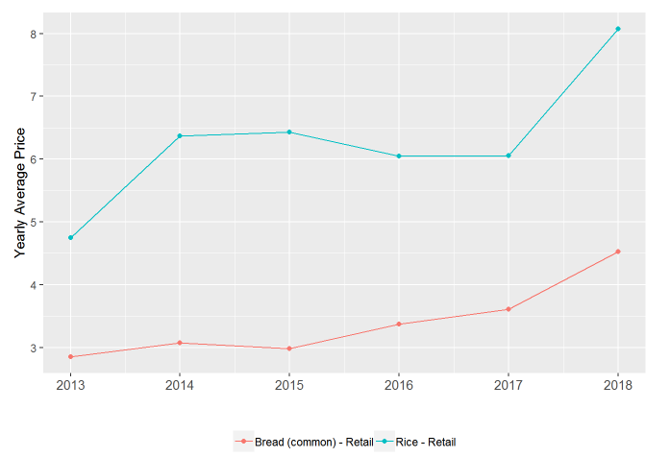
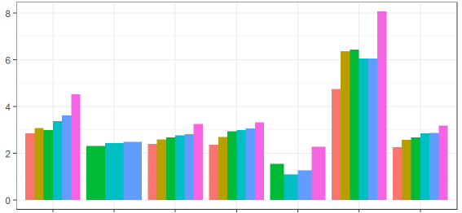
Yearly Average Price for Cereals and Tubers
Bread
Bread (Pita)
Bulgur
Pasta
Potatoes
Rice
Wheat Flour
Increased
Flour Price
Weather
Conditions
Decreased
Supply
Exchange Rates

Slide 5
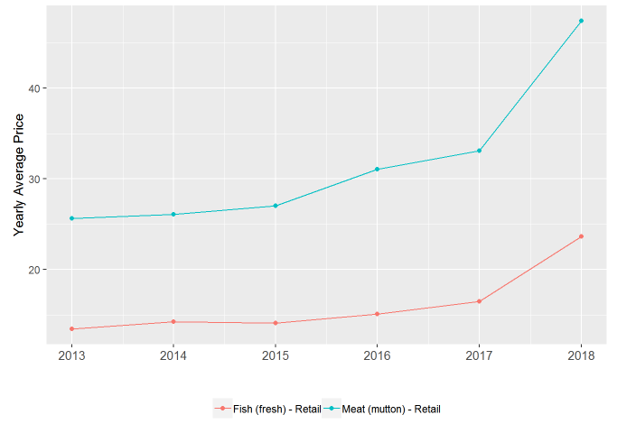
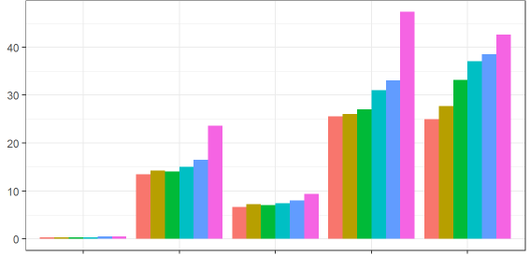
Yearly Average Price for Meat, Fish and Eggs
Eggs
Fish (fresh)
Meat (chicken)
Meat (mutton)
Meat (veal)
Exchange
Rates
Increased
Meat & Chicken
Price
Higher Demand
for Fish
Weather
Conditions
Decreased
Fish Supply

Slide 6
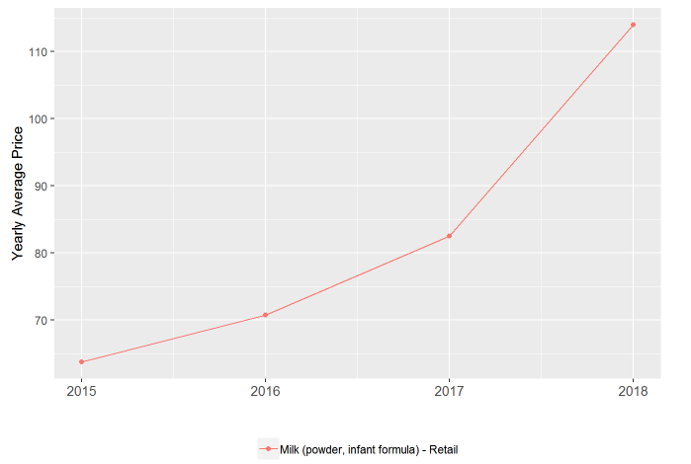
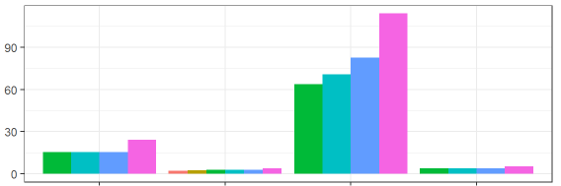
Yearly Average Price for Milk and Dairy
Cheese
Milk (Pasteurized)
Milk (powder, infant formula)
Yogurt
Social Security

Slide 7
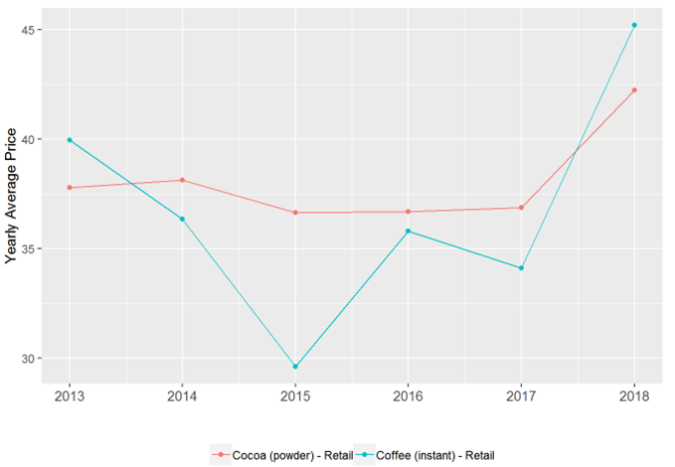
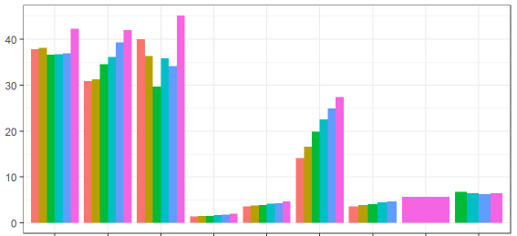
Yearly Average Price for Miscellaneous Food
Cocoa (powder)
Coffee
Coffee (Instant)
Salt
Sugar
Tea
Tea Green
Tea (Herbal)
Tomatoes (paste)
Decreased
Supply
Increased Demand
&
Climate Change

Slide 8
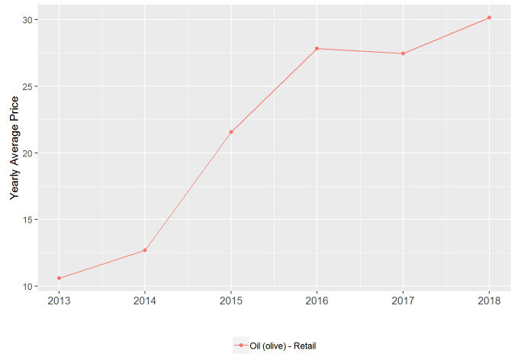
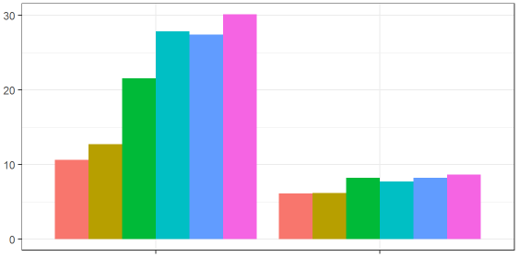
Yearly Average Price for Oil and Fats
Olive Oil
Sunflower Oil
Climate Change

Slide 9
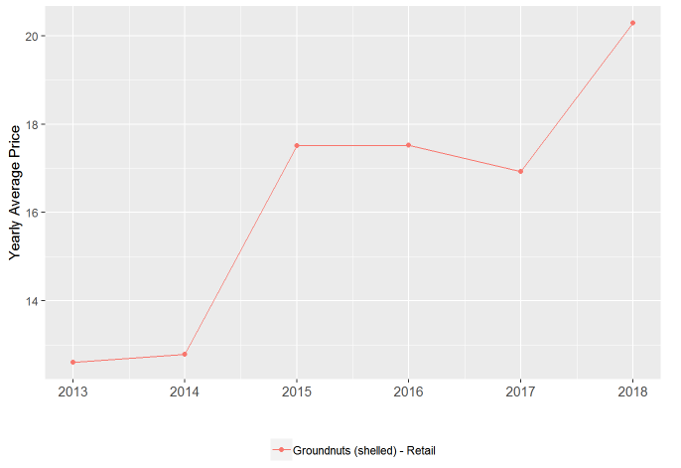
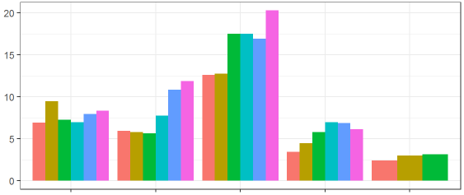
Yearly Average Price for Pulses and Nuts
Beans
Chickpeas
Groundnuts
Lentils
Peas
Lack of Production

Slide 10
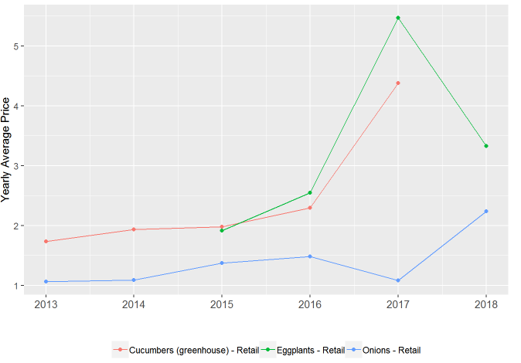
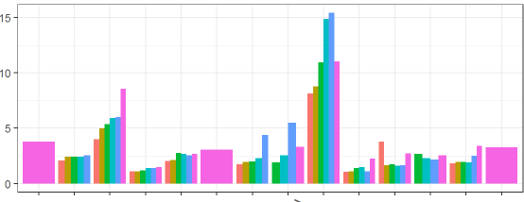
Yearly Average Price for Vegetables and Fruits
Apples
Bananas
Cabbage
Cauliflower
Cucumbers (greenhouse)
Eggplants
Garlic
Onions
Oranges
Spinach
Tomatoes
Zucchini
Cold Weather
Floods
Frozen
Onions

Slide 11
Conclusion
In line with our analysis, we can conclude that most of the food prices in Turkey seem to have increasing trends majorly due to:
Climate change impact such as drought, excessive rain fall etc.
Natural causes such as pest infestation
Current currency rates crisis
Higher demand due to increasing population
Insufficient supply as oppose to high demand
Price changes all over the world, especially for imported ones
In addition, we can say that 2018 food prices in Turkey have increased overall with a few exceptions in line with the reasons explained
above.

